Slide 1
Migrating to events
Gunnar gestsson – Advania & Dynamics.is
Notes:
Preparations;
Start Edge and Web Client
Start Windows Client, go through Sales Posting and Group Test to warm up the server

Slide 2




About me
Gunnar Thor Gestsson
Microsoft Dynamics NAV Architect @ Advania Iceland
Microsoft MVP
gunnar@dynamics.is | dynamics.is | objects4nav.com
@gunnargestsson
Notes:
I have been working with NAV since the DOS version in 1994. My home is in the north cost of Iceland and I just started my fourth year as an Microsoft MVP. This spring I got the change to get my knowledge certified and I grabbed that change to be a Dynamics Credentialed Professional.

Slide 3
Out goal for today
The Events shipped with NAV and Dynamics 365 for Financials
When are Events executed and what data is available
Examples of how customization can be done using Events
Few things that are of interest to me and I want to talk about
Notes:
In NAV 2017 and Dynamics 365 for financials we have the second generation of events. The event functionality is identical from NAV 2016. There are more integration events and there are business events in NAV 2017 and Dynamics 365 for financials. To use these event we need to know where to find them and how to use them. I will briefly talk about how and where to find a list of events.
In a given business process, events are executed quite frequently. When we are tasked with extending or modifying that business process we need to know when in that process events are executed and what we have to work with at that given moment. For that purpose I created a solution to log the events and the data available. We will look closely into this.
When we have located the events we want to use we can start our task. In my third section I will show a few examples of how I choose to use events in some common scenarios.
And since this is a developers conference and I love to talk about development I will end this by talking about few things that I find interesting and would like to share with you.
I will dive into C/AL code and explain what and how for every process.

Slide 4
First goal
The Events shipped with NAV and Dynamics 365 for Financials
Notes:
Now let’s get started

Slide 5
Event Types
Business Events - A business event is a custom event that is raised by C/AL code. It defines a formal contract that carries an implicit promise not to change in future releases. It is the expectation that business events are published by solution ISVs, including Microsoft.
Integration Events - An integration event is also a custom event that is raised by C/AL code, like a business event, except that it does not carry the same promise of not changing, nor does it have the restriction not to expose implementation details.
Global Events - Global events are predefined system events that are automatically raised by Codeunit 1 ApplicationManagement.
Database Trigger Events - Trigger events are automatically raised by the system when it performs database operations on a table object, such as deleting, inserting, modifying, and renaming a record, as defined in a table .
Page Trigger Events - Page Trigger events are raised automatically by the system when it performs certain operations in a page object.
Notes:
Here we have the list of event types directly from Microsoft.com. Business and Integration Events are raised by creating a function in any NAV object and by using properties to define that function as a event publisher. Microsoft has already places numerous events where they suggest that the application could be extended. Since NAV 2016 and increasingly in NAV 2017 and Dynamics 365 for financials, Microsoft is building solutions with the extension model, for example the Data Migration functionality is exclusively built on event and shipped as an extension. When you have done your data migration work you can simply uninstall that extension. More than one hundred integration events and few business events have been added to the latest release.
Global Events are the Integration events in Codeunit 1. Codeunit 1 has functions that are executed by the platform. By subscribing to Global Event you can effect the basic functionality of the system.
Database and Page events are system events. They are there for all tables and pages and nothing is needed in code to make them execute.

Slide 6
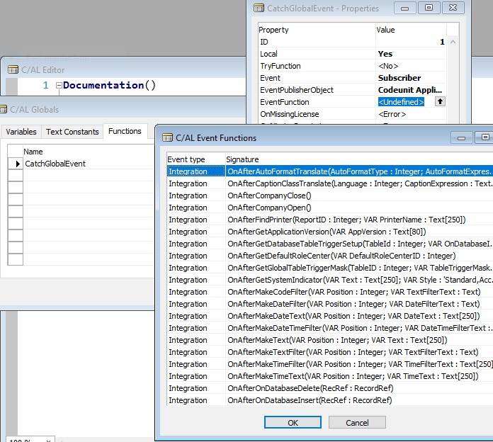
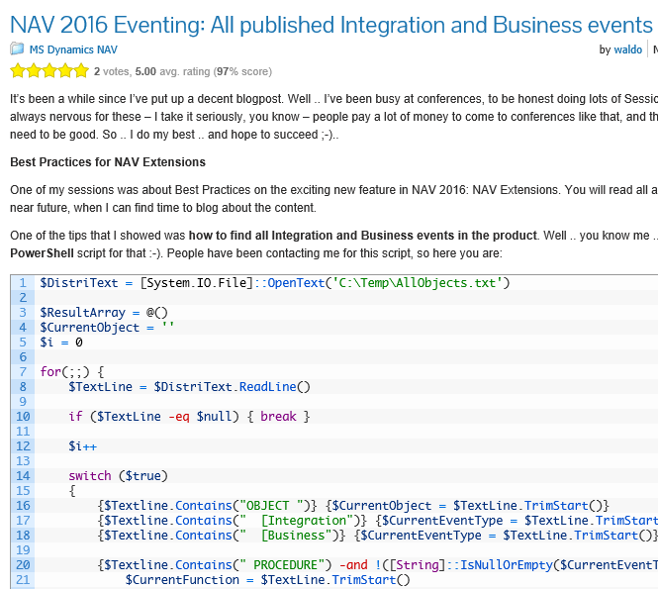
How to find events
List in development environment
Export objects and use PowerShell (waldo.be)
Notes:
Microsoft does not maintain a public list of events. The way to find a list of possible events is by lookup in the development environment. There you create a subscriber function, point to the publisher object and use the lookup to get a list of events.
If you are looking for a list of all the business and integration events in the application you can use Powershell against the exported object textfile. Waldo has published the script on his blog and just recently published a list of business and integration events in NAV 2017 and Dynamics 365 for financials.

Slide 7
Catching an Event
Behind the scenes
Notes:
Create new Codeunit and a function to catch the company open trigger – message “Hello world…”
Open the windows client with Select Server…

Slide 8
Second goal
When are Events executed and what data is available
Notes:
Always good to have our fist goal easy. Now for the second goal. That will take us some time…
If we are plugging into a business process we better know the correct place.

Slide 9
Where are the Events
Publisher functions in any object type to start integration or business events
Pages start multiple events when opened, used and closed
Tables start multiple events when data is validated and updated
Global events start for multiple actions, including data update
Notes:
While executing a business process the application fires multiple events. Event caused by an executing code or by the user interaction with the system. All the previously listed event types can execute and a single user interaction can fire multiple events.

Slide 10
Which Event should be used
?
Notes:
This is the question you need to ask your self. Trying to answer this question I created a small tool to log the execution of events and the data that is available at that time and place. Let me show you that.

Slide 11
Event logging demo
Behind the scenes
Notes:
Start page 85000. Talk about the functionality of then event publisher log.
Test Temporary Customer
Test Customer
Test My Customer Card and Update the Customer Name – show database record before and after modify
Test Create Sales Invoice and Post

Slide 12
Recap
Temporary Customer created, updated and deleted
Customer created, updated and deleted
Customer created and updated using My Customer Page
Sales invoice created and posted
Notes:
We could see that each of this processes executed a number of events. Each giving us different possibilities and different data. The code that does this logging will be made available and if you want to log your process you will need to write some code to do that. Let’s dive into C/AL.

Slide 13
Event logging demo
Behind the scenes
Notes:
Show Table 85000, Codeunit 85000 and Codeunit 85010

Slide 14
Third goal
Examples of how customization can be done using Events
Notes:
I found a few cases where we used to make customizations for our clients and wanted to apply the same change to my NAV 2017 database using events. By using the events I make sure that my customization can easily be shipped as delta files and can easily be converted into an extension both for NAV 2017 and for Dynamics 365 for financials

Slide 15
Customizing the Role Center
Behind the scenes
Notes:
Start Page 85000 and go to User Personalization. Talk about having no default profile and the profile ID in User Personalization (the system one) must be blank.
Switch between client types in Edge. Subscriber in Codeunit 85040

Slide 16
Add an editable field to Customer Ledger Entry
Behind the scenes
Notes:
Show Table 21 and Page 25. If the field is editable in Page 25 Codeunit 85044 is required to update both the entries and the details

Slide 17
Responsibility Centers
Behind the scenes
Notes:
Responsibility Centers are used in companies to put employees into groups by processes or by location. Start Page 85000 and Responsibility Centers. This is an example of a printer selection based on the responsibility center. Codeunit 85043 will subscribe to the Global Event OnFindPrinter and look to the printer selection based on the responsibility center code selected in the user setup. In that Codeunit we also have an example of how the customer list and the customer card are filtered based on that same value.

Slide 18
New Code field for Sales Documents
Behind the scenes
Notes:
The Code field we added to our Customer Ledger has also been added to our Sales Header. In Sales Posting we need to populate this field in the Customer Ledger Entries. Option #1, Codeunit 85045 will find the already inserted customer ledger entry and update it based on the unposted document. Option #2, Codeunit 85046 will also find the already inserted customer ledger entry when the sales invoice is updated with the information about the newly inserted customer ledger entry. The Code will be copied form the posted document to the customer ledger. Option #3 and #4 will be covered later.
Start Page 85000 and go to Sales Posting.
Create an invoice and point to the new Code field. Put something into that field and post the document. Look at the events and talk about possible places to subscribe to get the code into the customer ledger.

Slide 19
Migrate to Events
Map the process you want to extend to find possible Events for you modification
Be creative when looking for a solution
Think about the Cloud, meaning different client types and Dynamics 365
Suggest Business and Integration Events
https://connect.microsoft.com/dynamicssuggestions/Feedback
Code Cloning and extra record modification are in some cases necessary
Notes:
Create your own event logging for the process you want to extend or modify. Make sure that you understand all the possible events you can use and make sure that the data available in the event you select is the correct data. Migrating to events may require you to repeat some of the processes that are performed by standard with your own modifications. In some cases you will have to live with cloning code to make your version of the process. We need to think in decoupled way, that is, what you create needs to be able to live separately from other parts of the solution. The part you create might end up being an extension for Dynamics 365 for financials.
Make sure that you are aware of different client types with different capabilities. Some of the things you may create will work differently on different clients. Your design must include those options.
If you are missing an integration event for your extension or customization you can ask for it on Connect. My experience is that if you are planning an Extension for Dynamics 365 for financials and require an event for that you are more likely to catch the attention of Microsoft.

Slide 20
Fourth goal
Few things that are of interest to me and I want to talk about
Notes:
Now to my personal part of the agenda.

Slide 21
Performance
Use the server cache and the server memory
Try to limit the no. of write transactions
Read will use the server cache and is very fast
Use temporary tables for all the heavy work and the insert the results
Use Single Instance Codeunits to store processing data
For sequential read queries are always fastest
Notes:
In all your design you need to think about performance. The modern NAV server is very fast when it comes to reading data. The server puts a lot of data into cache memory and can fetch that data as fast as if it in the session memory. You most likely all remember creating a function to get a record from a setup table. You included a Boolean variable to know if you already have that record in your session memory. This, for example, is no longer good practice. Just unneeded extra code.
If you have not already done so, get familiar with queries. They are always the fastest way to read data. A query is executed on the SQL server and then NAV server only asks for the required fields, while a normal table read always reads all the fields from the record. The modern NAV server is now smart enough to do similar queries if you include Flowfields in your request. In code make sure to use SETAUTOCALCFIELDS to activate that functionality.
A developer should avoid using COMMIT. In my company we sometimes ask if that developer has a license to commit. Try to do as much as possible in memory and in temporary tables before committing the transaction to the SQL server.

Slide 22
Single instance
Behind the scenes
Notes:
Take a look at codeunits 85002. This codeunit can store all simple variable types. The Dictionary is a dotnet variable that can store a collection of variables based on a variable name. Open Codeunit 85042 – Ship-to Address Management and talk about asking the question before transaction. Same principal in Codeunit 85041 – Sales Inv. Printer Selection. Point to the Client Type test – asking for a printer has no use in web or touch client nor in a web service.
Do a walkthrough on Option #3, Codeunit 85047 will save information about the invoice that is about to be posted and before the customer ledger entry is inserted the Code value will be fetched from memory. After posting the memory is cleared. Codeunit 85049, Option #4, gets the same result but uses a Single Instance Record Storage
Start Page 85000 and go to Sales Posting
Create an invoice on customer 10000 as a demo for all three features – do post and send.

Slide 23
Shared Temporary Table
Behind the scenes
Notes:
Shared Temporary Tables are a great tool to work with a set of data in multiple objects.
Start Sales Posting, create an invoice and add the TrainTicket.pdf. Close and show My Record Links
Open My Customer Card to show the secondary link factbox. Show Codeunit 85004 and talk about storing a single instance temporary record link to display in the factbox.
Shared temporary table can also be used to have access to the same live data in multiple objects.
Show the POS demo that is based on a single temporary table.

Slide 24
Grouping Test
Loop through customers
For every record check if the grouping record exists. If not it is created
For every record the group counter is increased
Execute a query based on customers
For every query line the grouping record is created
Loop through customers
For every record check if the temporary grouping record exists. If not it is created
For every record the temporary group counter is increased
Loop through the temporary grouping records and insert group records
Read all customers in order of the group field
For every grouping code count customers and insert grouping record
Skip to the last customer for that grouping code
Notes:
Imagine having to loop through a bunch of records and count each set. I have, for demo purposes, create four different ways to loop through customers and count how many customers are for each posting group.
The legacy method. Read all customers sequentially, get and update the grouping record
The query method. Create a query that groups and counts customers and insert result directly into the grouping record
The temporary method. Read all customers sequentially, get and update the temporary grouping record and finish by writing the results to the grouping record.
The skip method. Sort customers by the group value and find the first. Filter and count records with that group value and jump to the last record before releasing that filter. Insert the resulted count into the grouping record.

Slide 25
Grouping test
Behind the scenes
Notes:
Start Events page and start Grouping Test. Execute the test and show the result data. Talk about the for different methods and show them in Codeunit 85050. Show how the query test is fastest but there is no difference between the temporary test and the skip test. The database grouping test is up to 10 times slower.

Slide 26
Questions
?

Slide 27
Thank you
The slides and my demo code will be published on my blog, www.dynamics.is
As usual the presentation is recorded and the recording will be available with all the content on www.mibuso.com
Enjoy the rest of the conference
Notes:
As soon as Luc gives me permission I will post the slide deck and the demo code on my blog. The session recording will be on mibuso.
I hope you have all enjoyed and hopefully got inspired to use events from now on.

